Slide 1
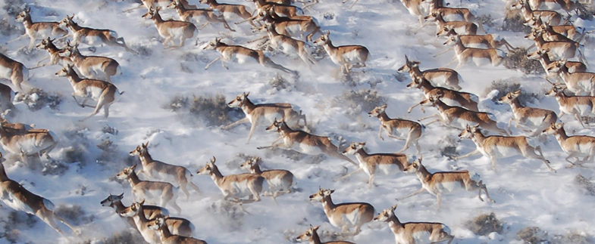

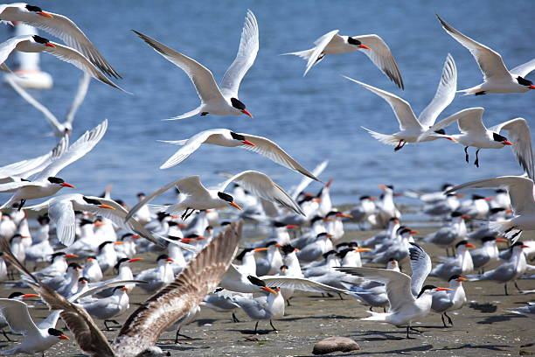
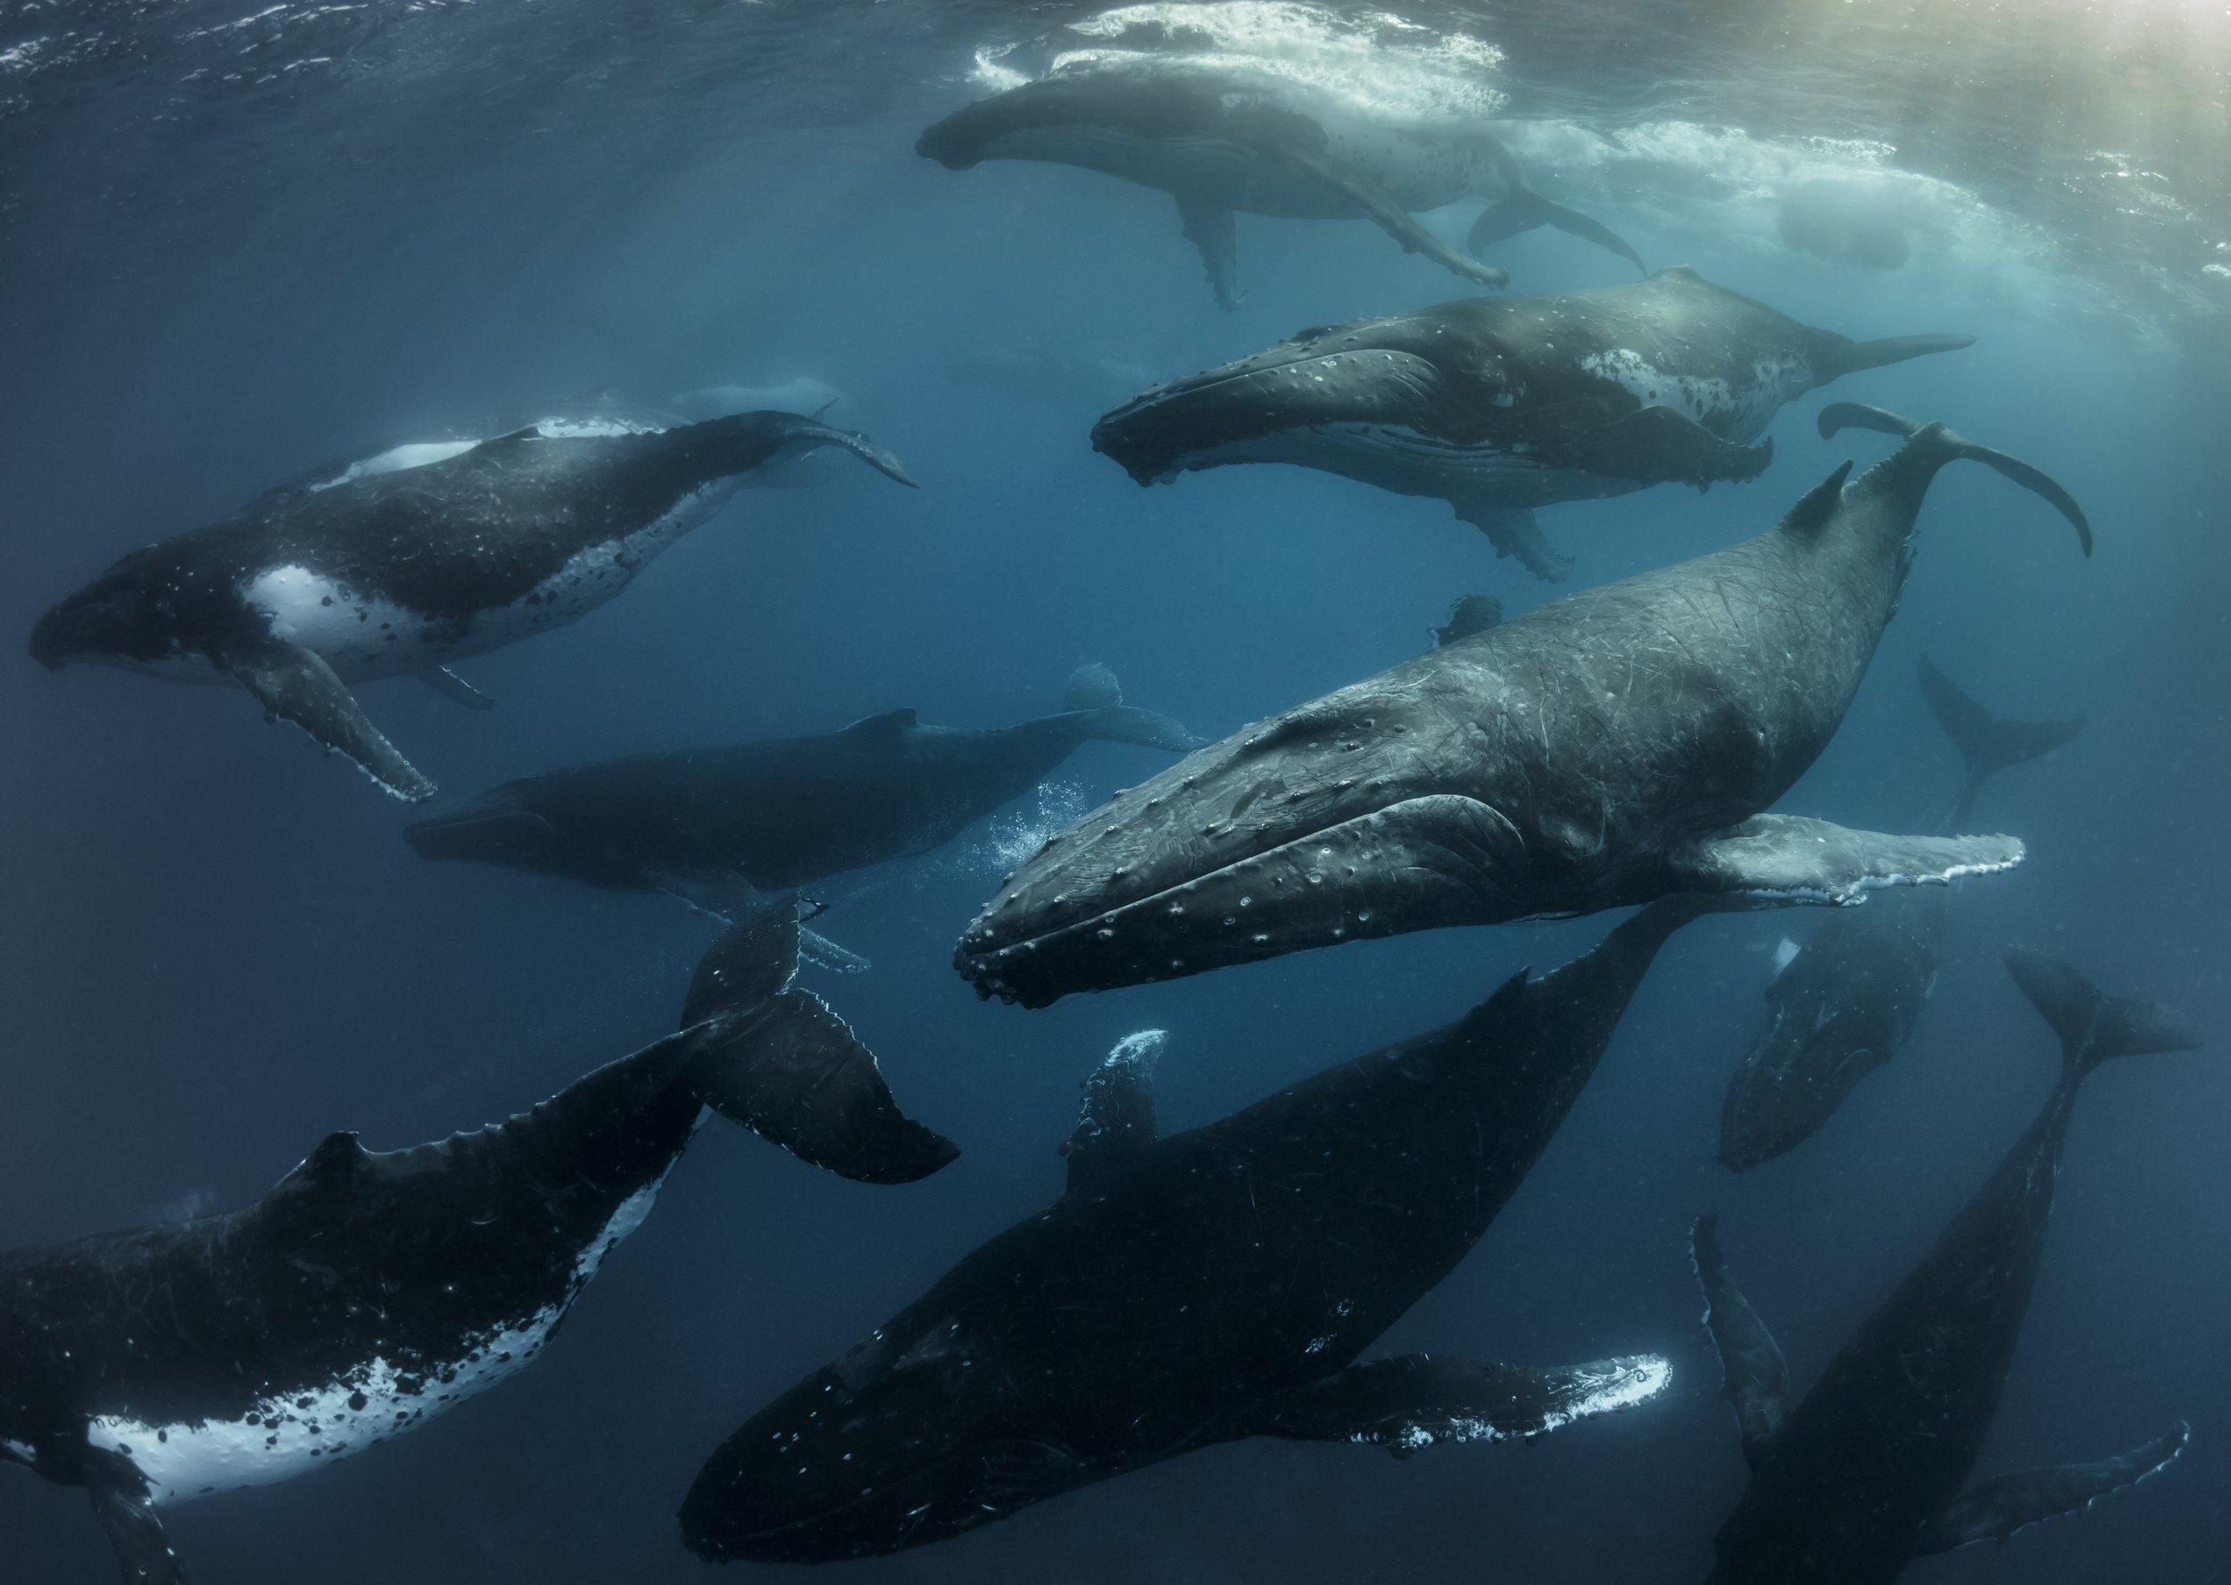





Movement Metrics
Jared Stabach and Wenjing Xu @ Fudan University | August 4 - 10, 2025

Slide 2
From raw data to analytical track
ç
The analytical trajectory
Sampling location at certain temporal interval
Actual movement path
Acknowledge our assumptions in this process!

Slide 3
From raw data to analytical track
Movement is locations through time
t₃
t₂
(x₃, y₃)
(x₂, y₂)
t₁
t₀
(x₁, y₁)
(x₀, y₀)

Slide 4

From raw data to analytical track
The ecological meaning is highly scale-dependent
STEPS
PATHS
Life-history stage
Birth
Lifetime track
Death
Notes:
Also to refresh what Thomas has discussed
Easily understandable if we relate to human movement

Slide 5
Movement metrics as the first analytical step
TRAJECTORY/PATH-LEVEL METRICS
SPACE-USE METRICS
Step length
Turn angle
Displacement
First passage time
Time to return
Straightness
…
Range estimate
MCP
KDE
LoCoH
dBBMM
…
Area use intensity
Home range fidelity
…
Turn angle correlation
Net-squared displacement
Notes:
Also to refresh what Thomas has discussed
Easily understandable if we relate to human movement

Slide 6
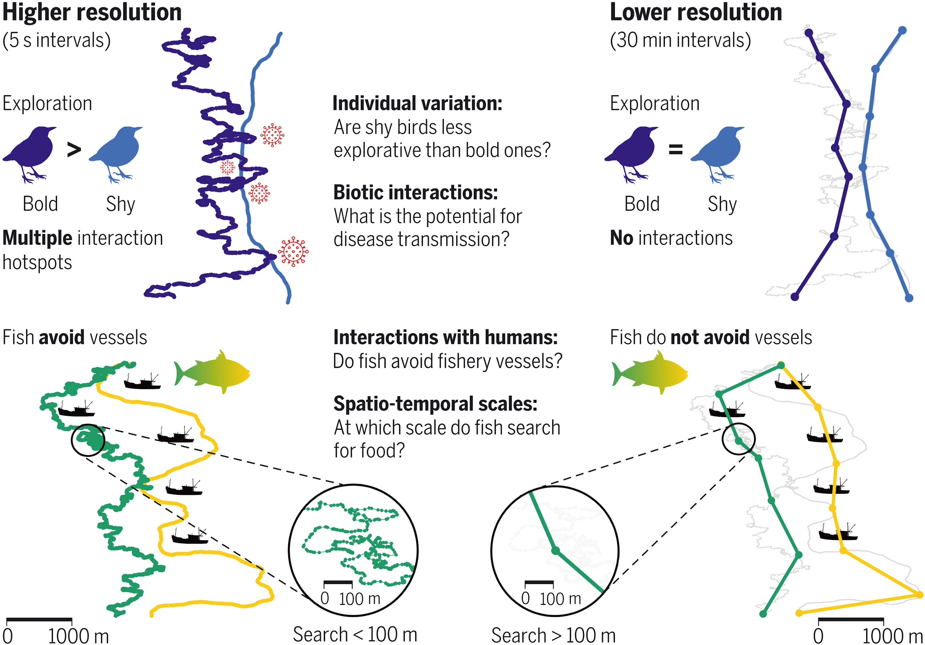
Always think about scale - does your data match your question?
The frequency, gaps, and shifts of movement data affects the calculation and comparability of movement metrics.
Nathan et al., 2022. Big-data approaches lead to an increased understanding of the ecology of animal movement. Science.

Slide 7
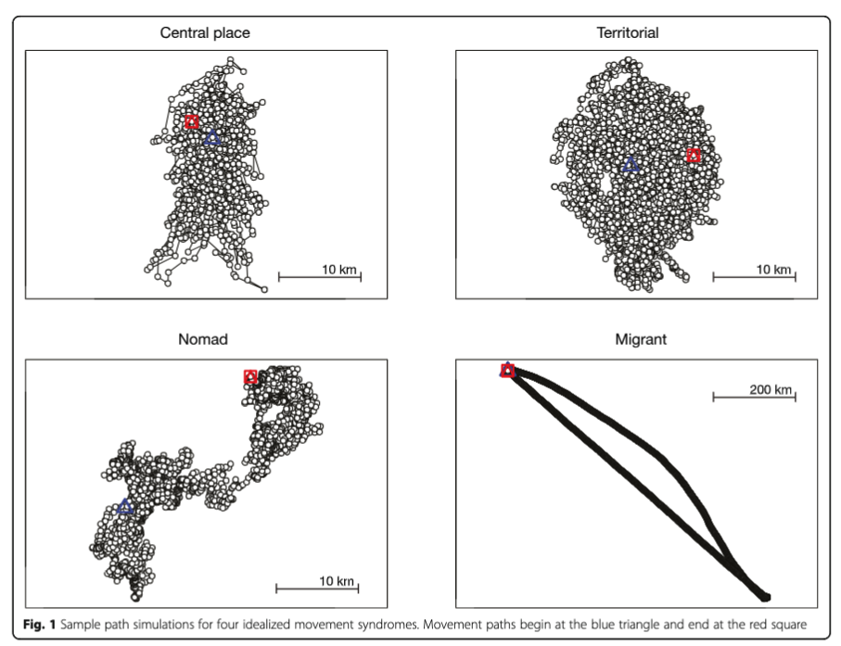
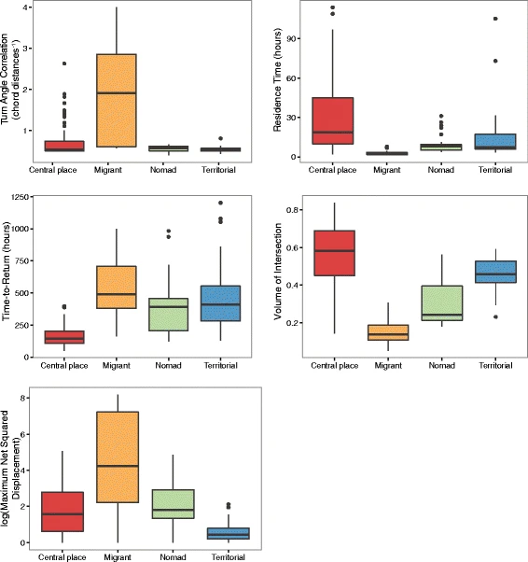
Movement metrics underlie behaviors (case 1)
clustering of movement metrics
Abrahms et al., 2017. Suite of simple metrics reveals common movement syndromes across vertebrate taxa. Movement Ecology.

Slide 8
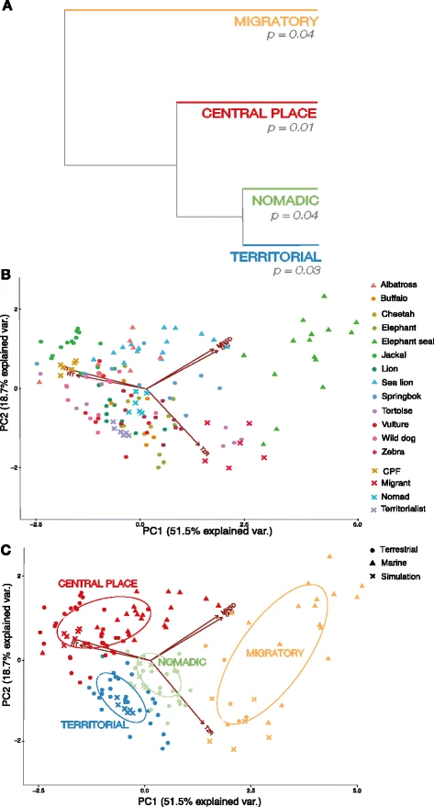
Movement metrics underlie behaviors (case 1)
clustering of movement metrics
Abrahms et al., 2017. Suite of simple metrics reveals common movement syndromes across vertebrate taxa. Movement Ecology.

Slide 9
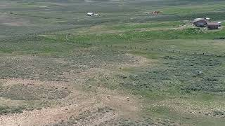

Slide 10
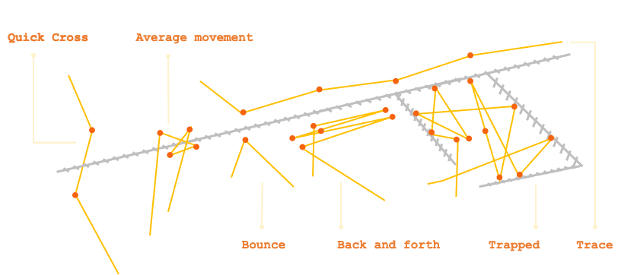
Movement metrics underlie behaviors (case 2)
Barrier Behavior Analysis
Xu, Dejid, Herrmann, Sawyer, and Middleton. (2021). Journal of Applied Ecology.

Slide 11
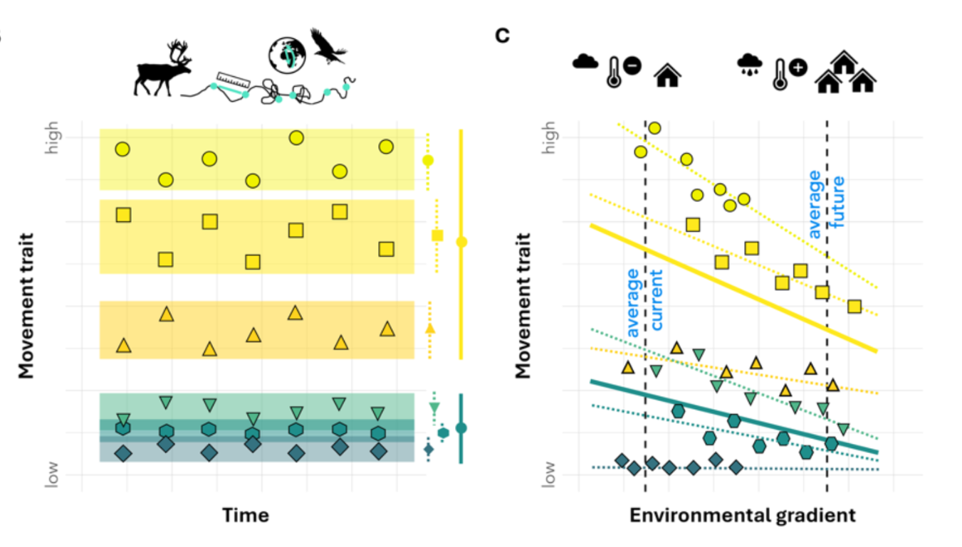
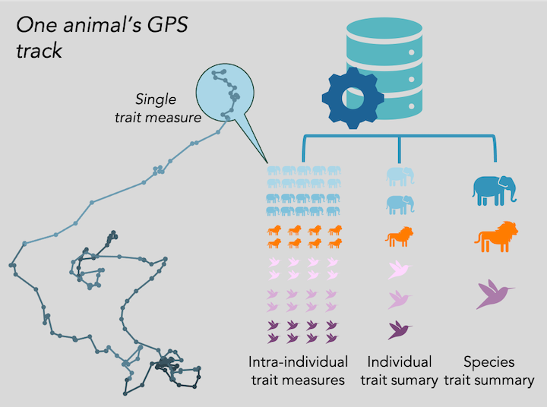
From movement metrics to movement traits
Standardized and comparable movement metrics to facilitate trait-based research on species interactions, community structure, and ecosystem functioning, and to support conservation and policy goals.
Beumer, Hertel, et. al., MoveTraits – A database for integrating animal behaviour into trait-based ecology. In review.
https://www.movebank.org/cms/movebank-content/movetraits

Slide 12
Questions?

Slide 13
How to analyze animal movement data
D
θ₂
l₂
C
Turning angle* θ₁
l₁
A
B
step length l₀
Turning angle: relative angle

Slide 14
How to analyze animal movement data
D
C
Heading θ
A
B
Heading: absolute angle

Slide 15
How to analyze animal movement data
D
C
A
B
Displacement

Slide 16
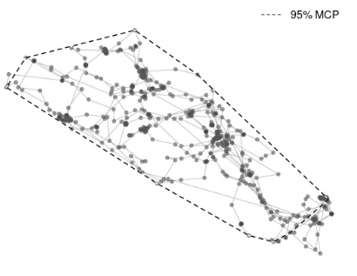
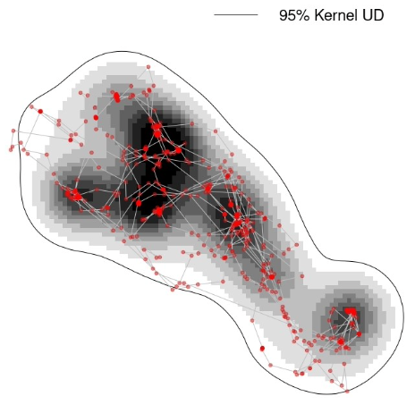
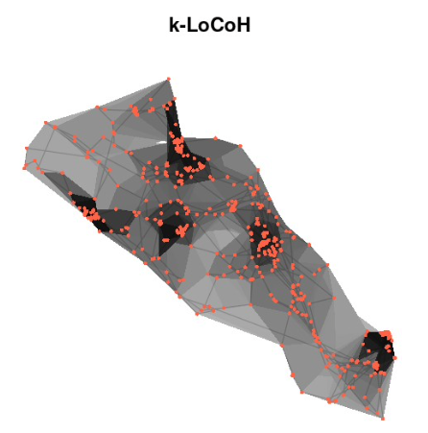
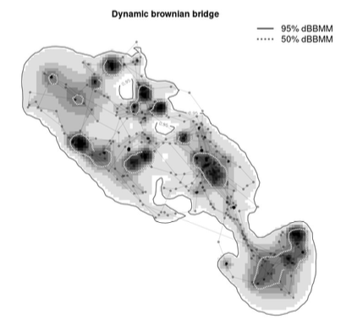
Assumptions
Data requirements
Figures from animove.org

